Slide 1
Introduction to Computer Vision
Image by kirkh.deviantart.com

Slide 2
Today’s Class
Introduction
What is Computer Vision?
Sample Problems

Slide 3
What is Computer Vision?
Computer Vision is about understanding images. These images can be
Greyscale or Colour or Multi-spectral
Snapshots or video sequences
Taken with a static or moving camera
Taken of a stationary or dynamic scene
Taken with a calibrated or un-calibrated camera
What Computer Vision aims to do is to extract some useful information from these images for…
Inspection purposes
Analysis purposes
Control purposes

Slide 4
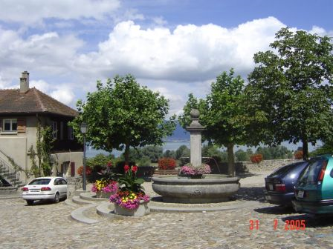
Computer Vision
What kind of scene?
Where are the cars?
How far is the building?
…

Slide 5
Computer Vision and Nearby Fields
Computer Graphics : Models to Images
Comp. Photography : Images to Images
Image Processing : Images to Images
Computer Vision : Images to Models

Slide 6
Computer Vision Scope
3D Scene Reconstruction
Stereo, Multi View
Shape from X (motion, focus, shadow, texture)
Time-of-ﬂight sensors
2D/3D Scene Analysis
Segmentation
Detection
Registration
Object Recognition
Augmented Reality

Slide 7
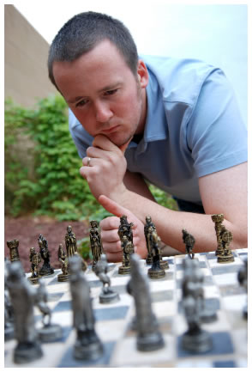
Vision is really hard
Vision is an amazing feat of natural intelligence
Visual cortex occupies about 50% of Macaque brain
More human brain devoted to vision than anything else
Is that a queen or a bishop?

Slide 8
Vision is really hard
"What we experience, apparently directly, is actually very different from what is recorded by our sense organs.“ [Perception: From Sense to Object by J. Wilding]

Slide 9
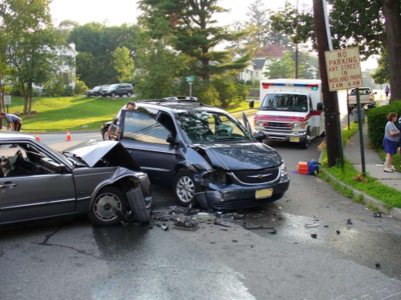
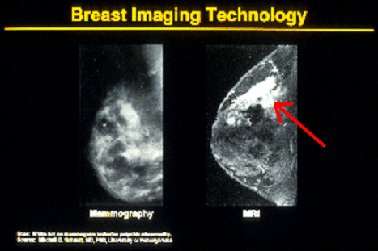
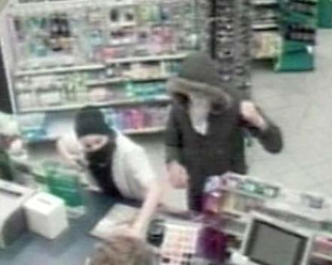
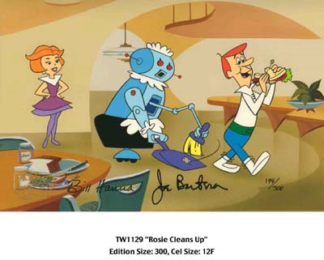
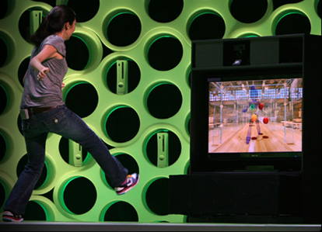
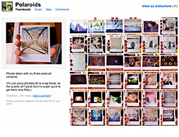
Why computer vision matters
Safety
Health
Security
Comfort
Fun
Access

Slide 10
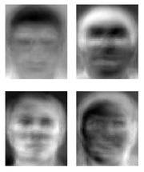
Ridiculously brief history of computer vision
1966: Minsky assigns computer vision as an undergrad summer project
1960’s: interpretation of synthetic worlds
1970’s: some progress on interpreting selected images
1980’s: ANNs come and go; shift toward geometry and increased mathematical rigor
1990’s: face recognition; statistical analysis in vogue
2000’s: broader recognition; large annotated datasets available; video processing starts
CNN, Deep Learning, Autonomous Vehicles
Guzman ‘68
Ohta Kanade ‘78
Turk and Pentland ‘91

Slide 11
How vision is used now
You just saw examples of current systems.
Many of these are less than 5-10 years old
This is a very active research area, and rapidly changing
Many new apps in the next 5 years
To learn more about vision applications and companies David Lowe maintains an excellent overview of vision companies http://www.cs.ubc.ca/spider/lowe/vision.html

Slide 12
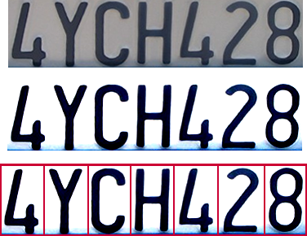

Optical character recognition (OCR)
Technology to convert scanned docs to text
If you have a scanner, it probably came with OCR software
Digit recognition, AT&T labs
http://www.research.att.com/~yann/
License plate readers
http://en.wikipedia.org/wiki/Automatic_number_plate_recognition

Slide 13
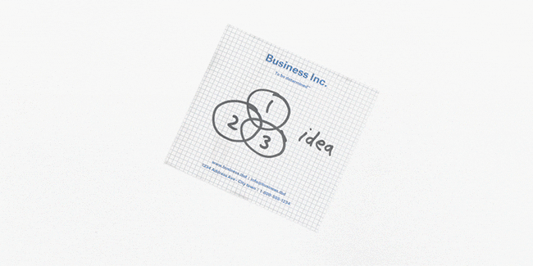
Dropbox OCR
Convolutional Neural Nets (CNNs)

Slide 14
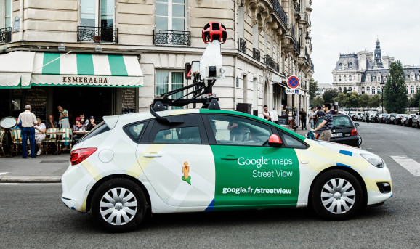
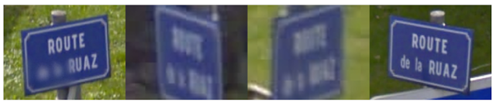
Optical character recognition (OCR)
Google Street View (84.2% accuracy)
street names, numbers, and businesses

Slide 15
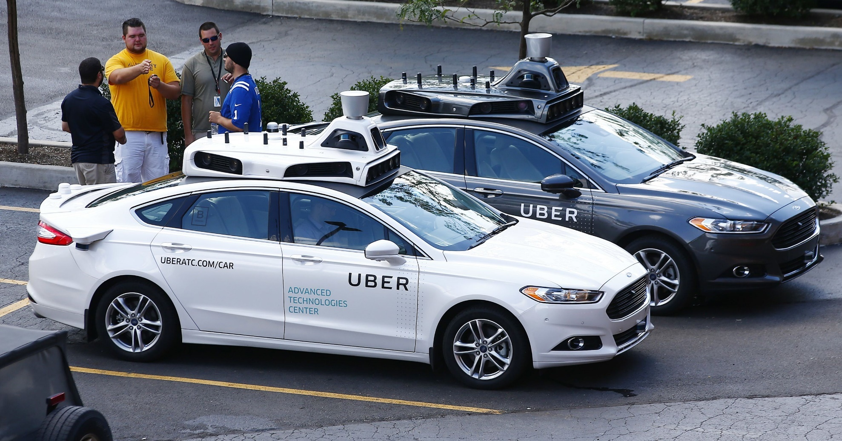
AutoCars - Uber bought CMU’s lab

Slide 16
Smile detection
The Smile Shutter flow
Sony Cyber-shot® T70 Digital Still Camera

Slide 17

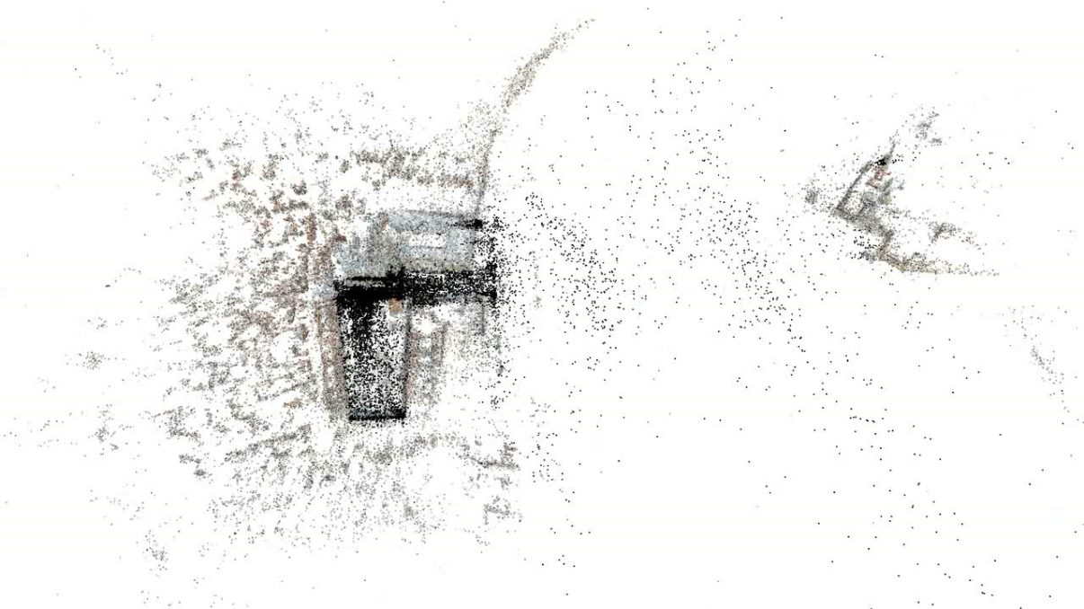
3D from thousands of images
Building Rome in a Day: Agarwal et al. 2009

Slide 18
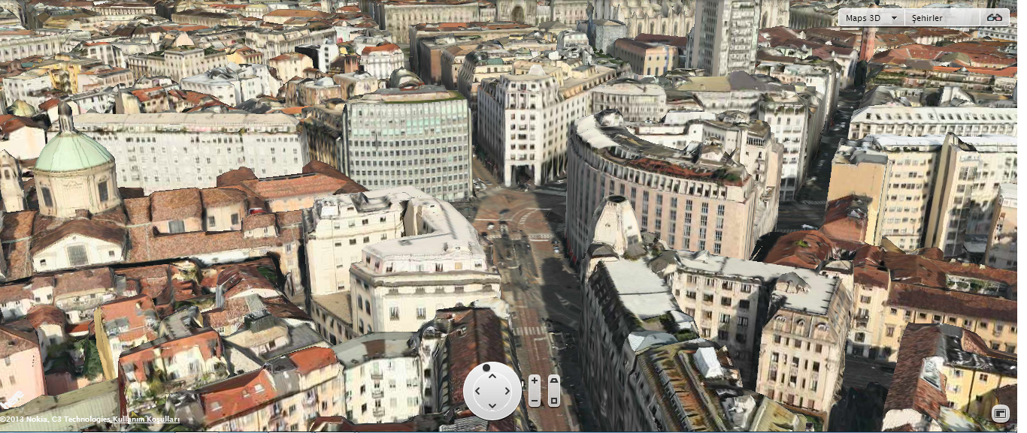
3D Maps with LIDAR
www.here.com

Slide 19
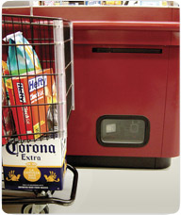
Object recognition (in supermarkets)
LaneHawk by EvolutionRobotics
“A smart camera is flush-mounted in the checkout lane, continuously watching for items. When an item is detected and recognized, the cashier verifies the quantity of items that were found under the basket, and continues to close the transaction. The item can remain under the basket, and with LaneHawk,you are assured to get paid for it… “

Slide 20
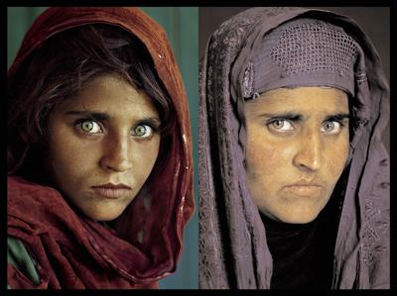
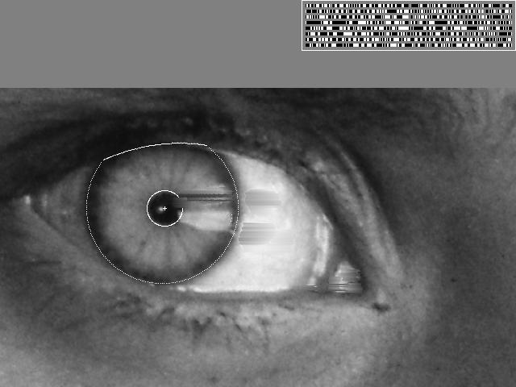
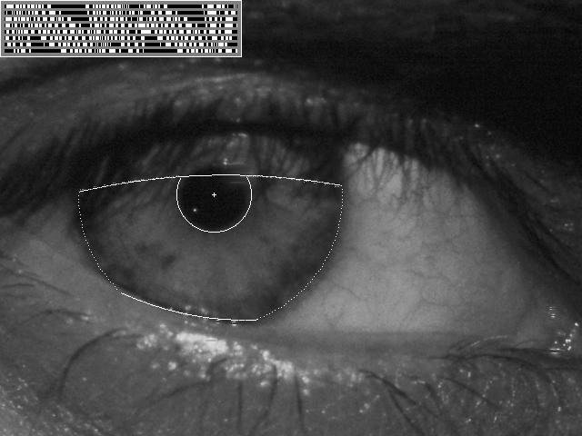
Vision-based biometrics
“How the Afghan Girl was Identified by Her Iris Patterns” Read the story
wikipedia
Notes:
Age 12, Age 30

Slide 21
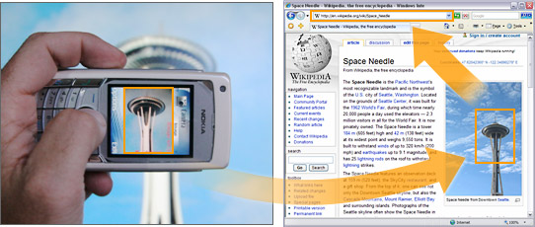
Object recognition (in mobile phones)
Point & Find, Nokia
Google Goggles

Slide 22
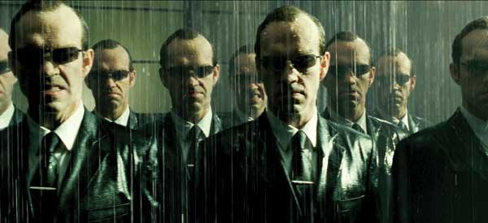
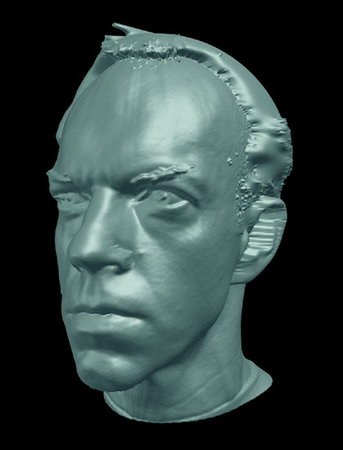
Special effects: shape capture
The Matrix movies, ESC Entertainment, XYZRGB, NRC

Slide 23

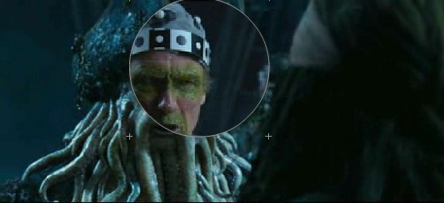
Special effects: motion capture
Pirates of the Carribean, Industrial Light and Magic

Slide 24
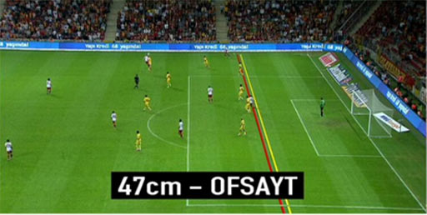
Sports

Slide 25
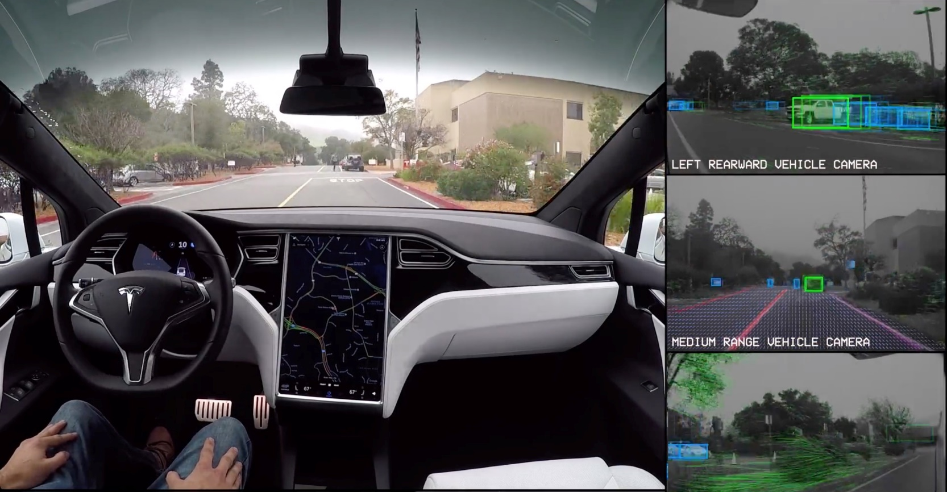
Smart cars
Tesla
Mobileye
Vision systems currently in high-end BMW, GM, Volvo model

Slide 26
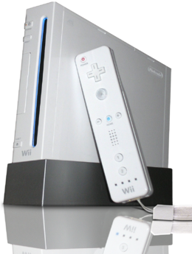
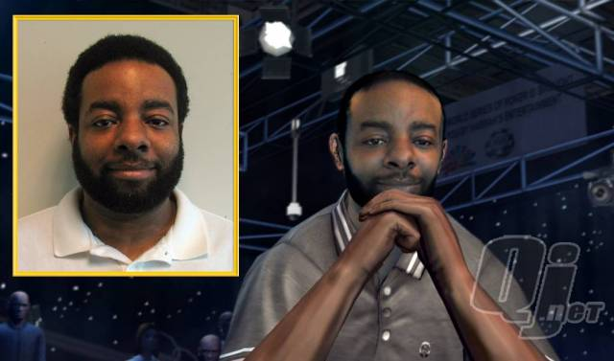
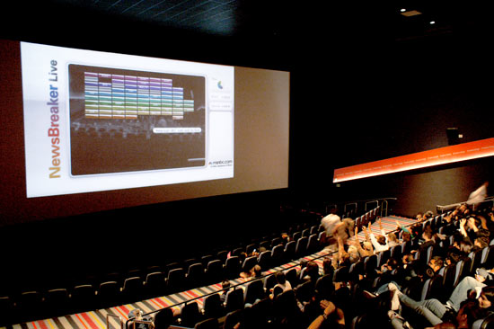
Vision-based interaction (and games)
Digimask: put your face on a 3D avatar.
Nintendo Wii has camera-based IR tracking built in. See Lee’s work at CMU on clever tricks on using it to create a multi-touch display!
“Game turns moviegoers into Human Joysticks”, CNET
Camera tracking a crowd, based on this work.

Slide 27
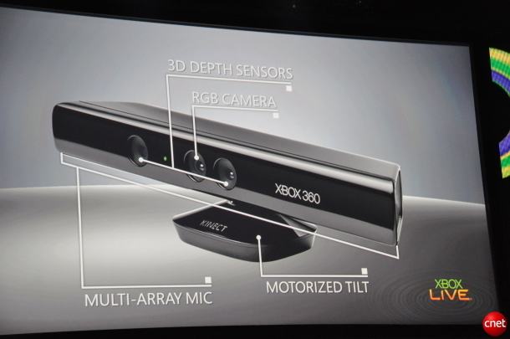
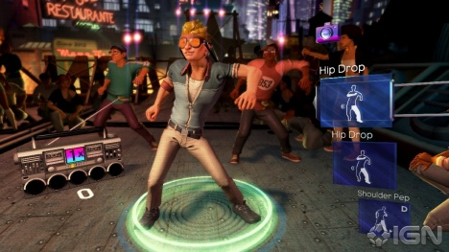
Interactive Games: Kinect
Object Recognition: http://www.youtube.com/watch?feature=iv&v=fQ59dXOo63o
Mario: http://www.youtube.com/watch?v=8CTJL5lUjHg
3D: http://www.youtube.com/watch?v=7QrnwoO1-8A
Robot: http://www.youtube.com/watch?v=w8BmgtMKFbY

Slide 28
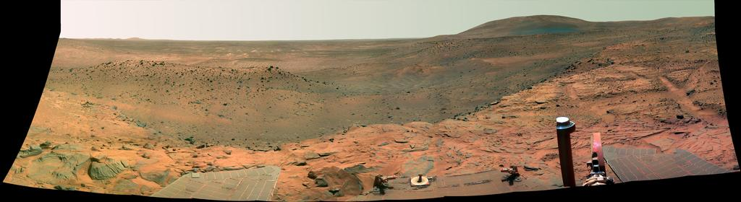
Vision in space
NASA'S Mars Exploration Rover Spirit captured this westward view from atop a low plateau where Spirit spent the closing months of 2007.
Vision systems (JPL) used for several tasks
Panorama stitching
3D terrain modeling
Obstacle detection, position tracking
For more, read “Computer Vision on Mars” by Matthies et al.

Slide 29
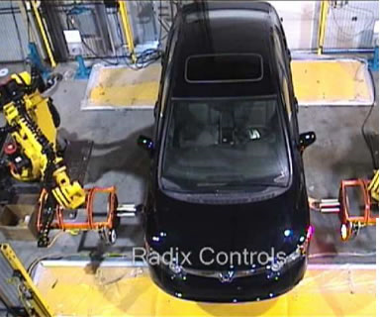
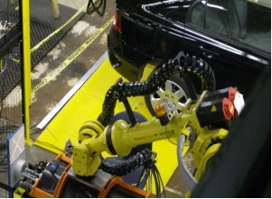
Industrial robots
Vision-guided robots position nut runners on wheels

Slide 30
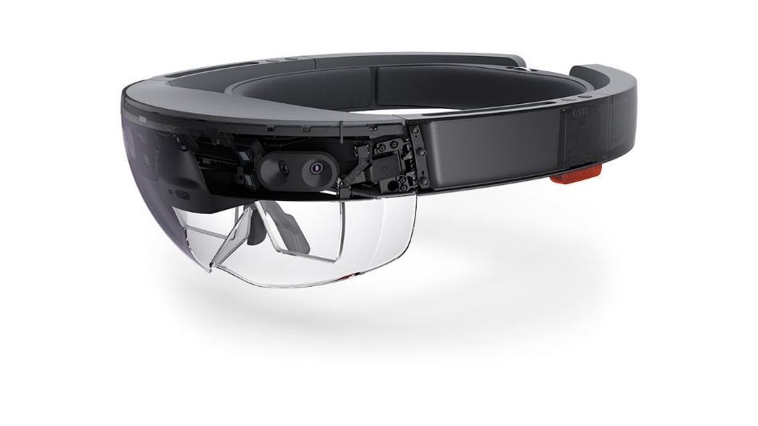
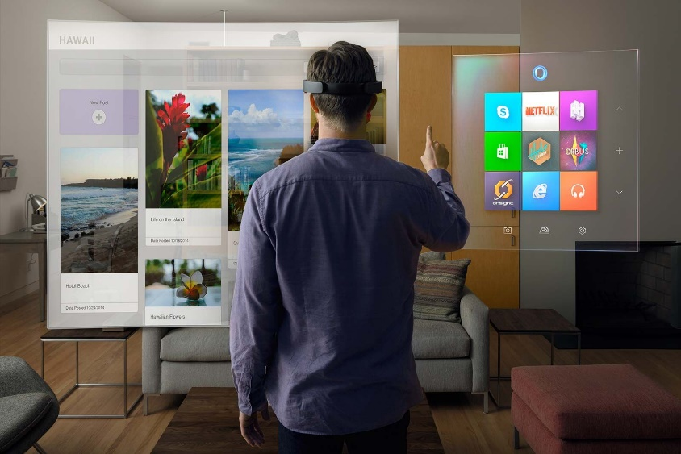
Augmented Reality

Slide 31
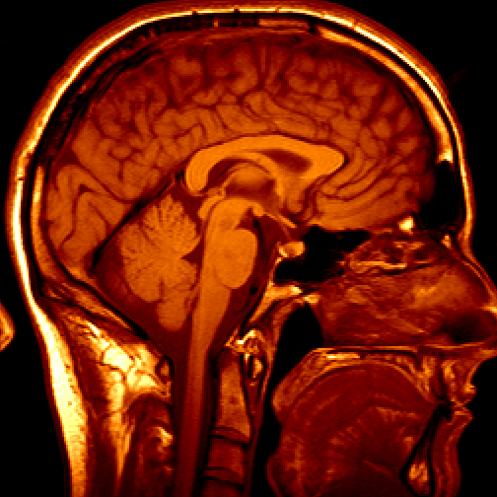
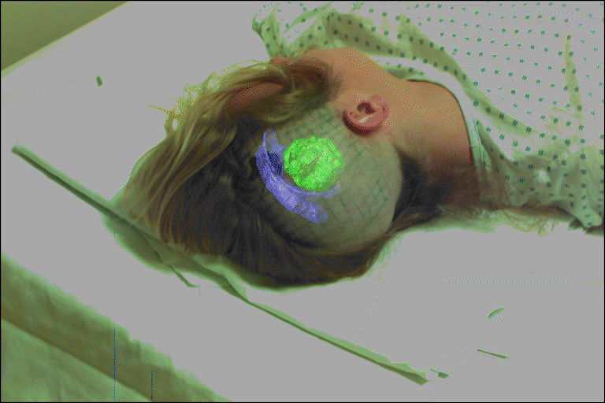
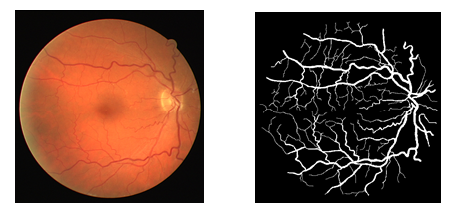
Medical imaging

Slide 32
Course contents
Basics of image processing
Digitization
Color models
Noise and Smoothing
Histograms
Geometric Operations
Edge Image Processing
Edge detection
Contour Following
Hough Transform
Camera models
Calibration
Features
Harris, FAST
SIFT
Video
Motion detection
Structure from X
Stereo
Motion
Object Detection

Slide 33
General Comments
Prerequisites
Data structures
A good working knowledge of a programming Language
(or willingness/time to pick it up quickly!)
Optional Matlab
Linear algebra
Course does not assume prior imaging experience
image processing, graphics, etc.
Book:
Computer Vision: Algorithms and Applications
A Practical Introduction to Computer Vision with OpenCV

Slide 34
Grading Policy
3 programming assignments
10%, 2-3 weeks each
1 midterm exam
35%
1 final exam/project
35%, open ended of your choice, but needs
project proposal after 4 weeks
Final report and working demo

